Slide 1



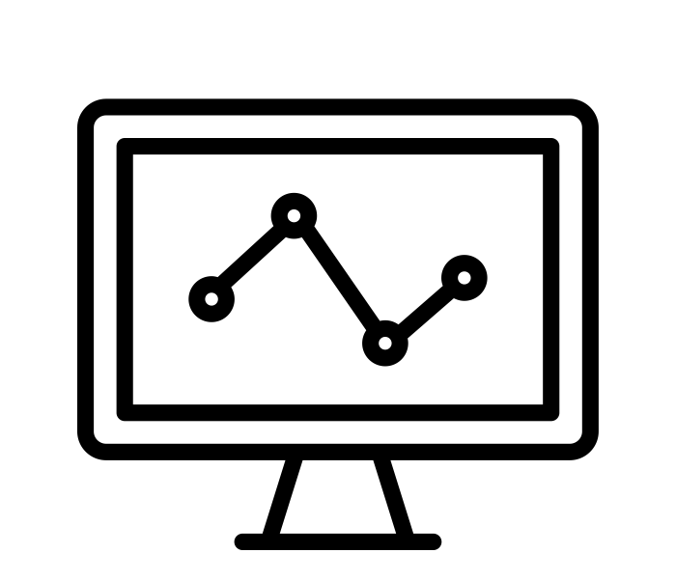






IT management, simplified.
Real-time IT management solutions for the new speed of business

Slide 2


Underpinning of a successful IT help desk
Incident management in
ServiceDesk Plus

Slide 3








Say hello to Zylker
BUSINESS USERS
IT FOLKS
SCOTT
IT TECHNICIAN
DAVE
HIRING MANAGER
JASON
IT TECHNICIAN
CIO
MARCUS
CATRIN
IT SERVICE MANAGER
ADAM
IT TECHNICIAN
WENDY
HR
JOHN
END USER

Slide 4
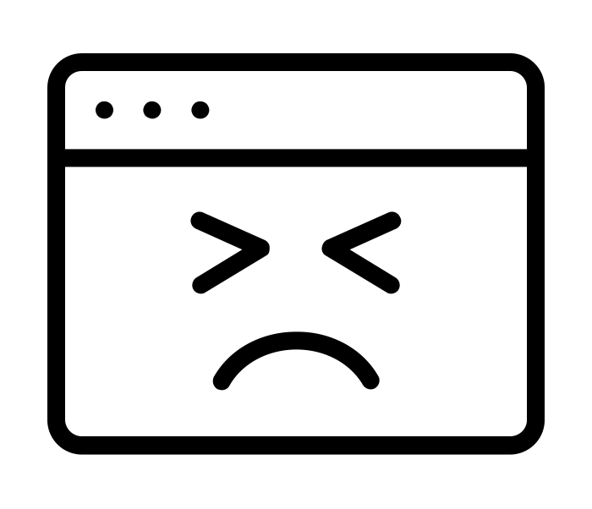
Zylker IT upgrades to
Windows 10
Incident management with ServiceDesk Plus

Slide 5



Zylker in trouble!
Things don’t work as planned.
Tickets are pouring in!
The keyboards and pointing devices are giving trouble!
THE IT TEAM
VPN drops connection!
I’ve got complaints. Apparently, some notebooks with 500 MB RAM don’t receive all the information.
The firewall and DLP software don’t run on Windows 10
I don’t think the four-port KVM switches are compatible!
VPN drops connection
Adam from the San Francisco site
Scott, company wide support
Jason from the Los Angeles site

Slide 6
How things should work
STEP 1
Catrin assigns the Windows 10 upgrading
to Jason and Adam in their respective sites.
Scott is in charge of the company
wide upgrading.
STEP 2
The IT technicians add relevant solutions to the
knowledge base to help resolve the upgrade-
related incidents.
STEP 3
Catrin makes a company-wide announcement
about the Windows 10 upgrade in ServiceDesk
Plus so that all users are aware of it.
STEP 5
Catrin automates the workflow for the anticipated
incidents and directs the tickets to the assigned IT
team for the Windows 10 upgrade.
STEP 4
Scott creates relevant forms and incident
templates and makes them available in the service
catalog. This prepares them to handle incidents
that may be triggered by the upgrade.

Slide 7



How things work at Zylker!
Who has an update?
Who is taking care of the Los Angeles issue?
What’s the status? I need an update NOW!
I need to know how many tickets we have from the Los Angeles site.
I took care of two tickets earlier today. Where are the rest?
We don’t have much time to resolve this. Productivity is at stake!
Um… I’m not sure if I should work on the VPN connectivity issue first or the tickets from the San Francisco site.
I have no clue on how many tickets we have received from each site.

Slide 8

The domino effect
How a series of events impacted productivity at Zylker
LACK OF SLA
Without proper SLA management, resolution times were longer.
LACK OF OWNERSHIP
Technicians were unaware of their responsibilities and the lack of ownership led to chaos and SLA violation.
LACK OF A STREAMLINED WORKFLOW
POOR TRACKING SYSTEM
Lack of a proper workflow led to pending tickets and tickets were assigned to wrong the technicians.
No proper mechanism to track IT tickets delayed the resolution process.
POOR COORDINATION BETWEEN SITES
LACK OF AUTOMATION
Lack of automation to prioritize and assign tickets to the right technicians resulted in delayed response and resolution time.
Lack of coordination between sites led to disorganized request management.

Slide 9
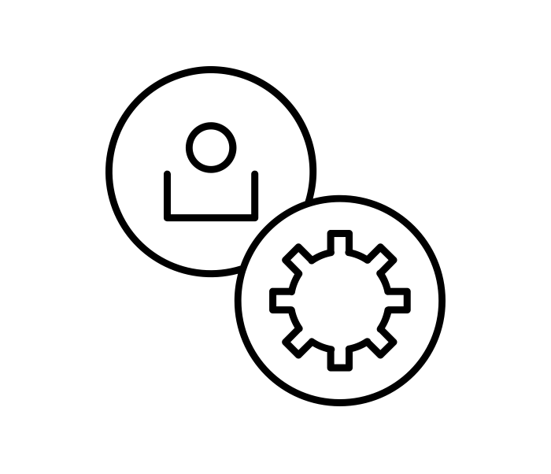
Incident management with ServiceDesk Plus
ServiceDesk Plus to the rescue!
A

Slide 10
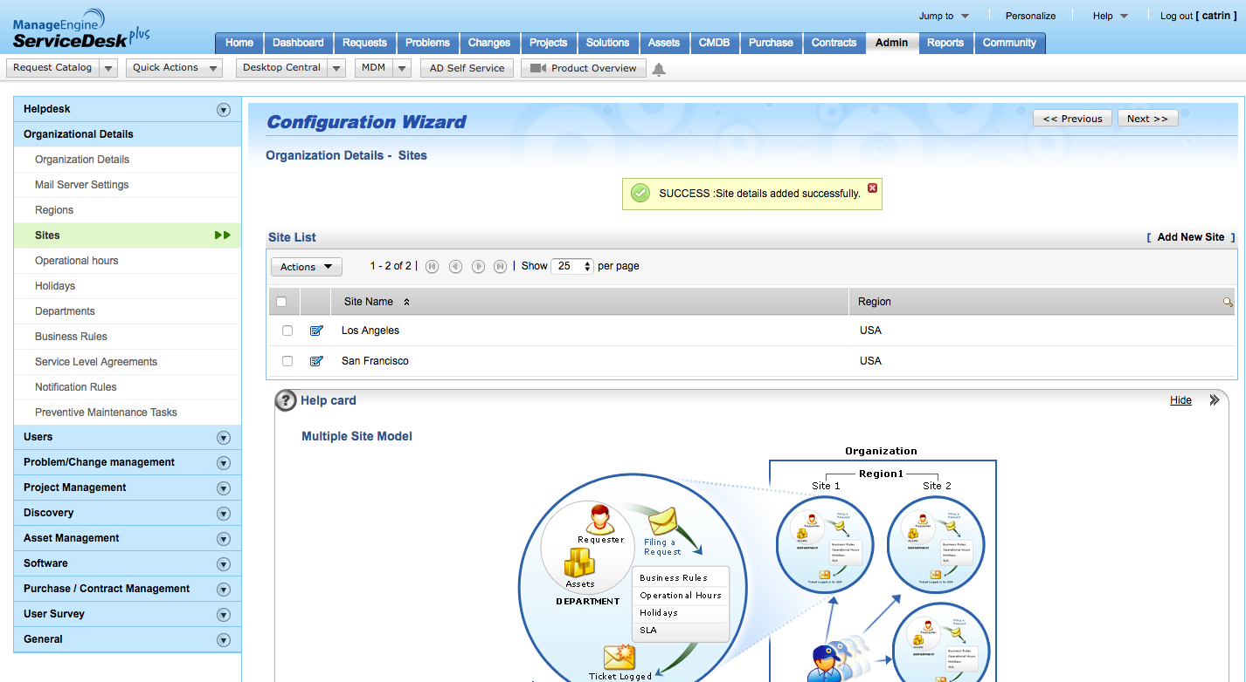
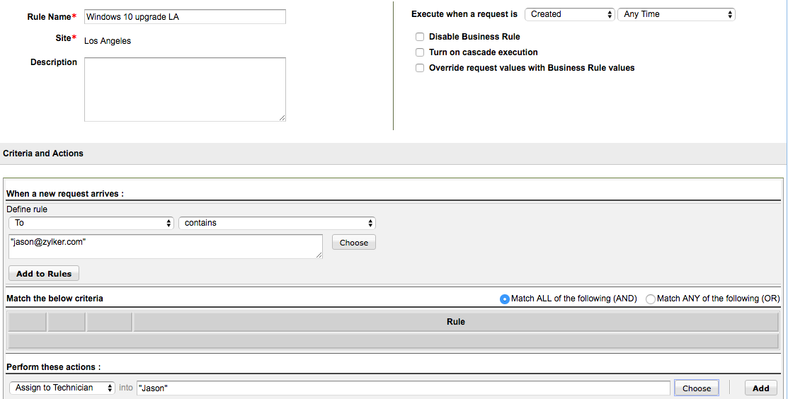
CUSTOMIZED WORKFLOWS FOR SITES
FEATURES: SITES AND BUSINESS RULES
Zylker is a fairly large organization with multiple sites. To manage all the sites on a common platform, Catrin, the company’s IT service desk manager and admin, creates separate workflows for each site in ServiceDesk Plus. For each site, she automates default workflows using business rules.
Catrin creates two separate sites for Los Angeles and San Francisco.
Creates a new business rule to divert all incidents from the Los Angeles site to Jason.

Slide 11
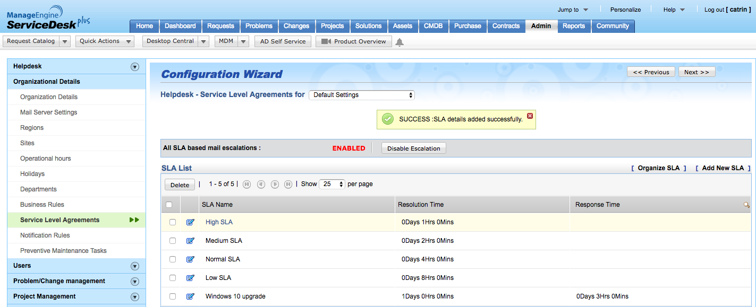
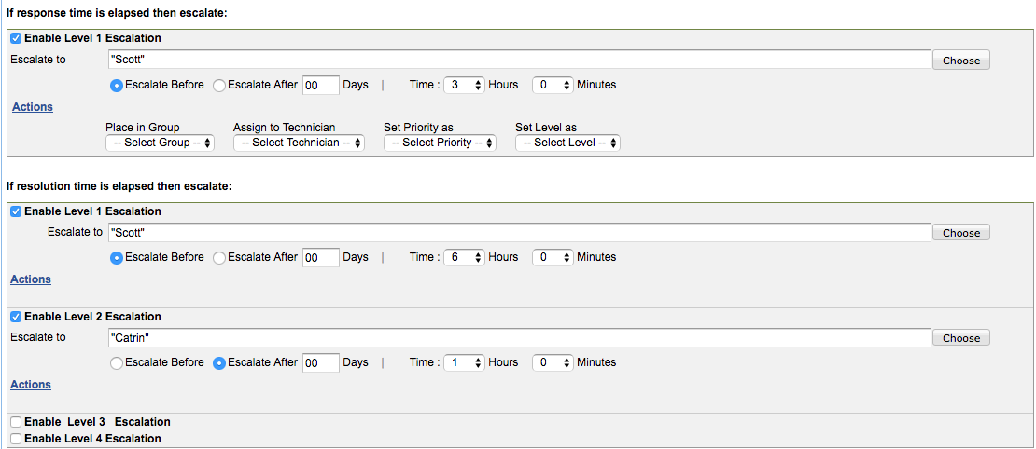
DEFINING RESPONSE AND RESOLUTION SLAs
FEATURE: SERVICE LEVEL AGREEMENTS
Catrin defines high response and resolution SLAs for the ‘Windows 10 upgrade’ issue.
Catrin creates stringent response and resolution SLAs for the Windows 10 upgrade issue.
Creates a new business rule to divert all incidents from the Los Angeles site to Jason.

Slide 12
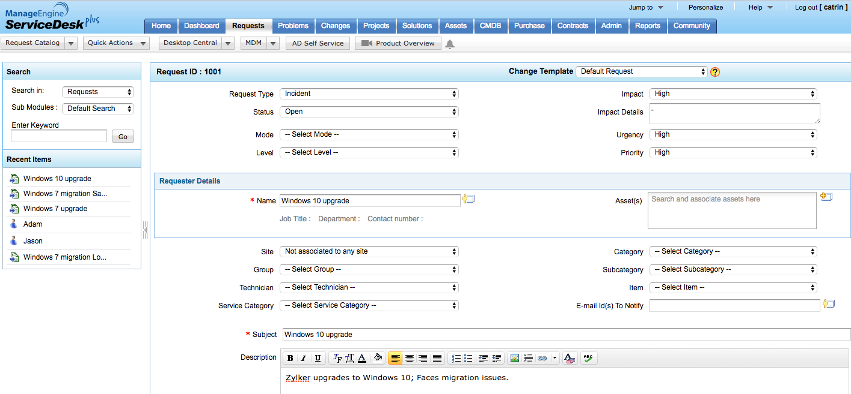
CREATING A MASTER TICKET FOR THE WINDOWS 7 MIGRATION
FEATURES: REQUESTS
Catrin creates a master ticket for the Windows 10 migration for Zylker using the ‘Requests’ module.
Sets the impact, urgency, and priority of the incident.
Catrin creates a master (parent) ticket for the Windows 10 migration.

Slide 13
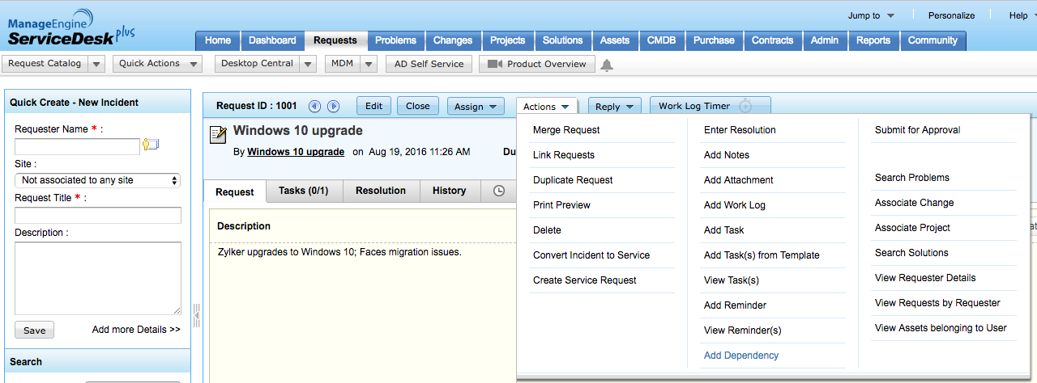
CREATING DEPENDANCIES BETWEEN REQUESTS
FEATURE: ADD DEPENDENCY
Catrin adds all the tickets pertaining to the Windows 10 upgrade as dependencies to the master (parent) ticket. This will help technicians keep track of the tickets that need to be worked on before the master ticket can be closed.
Catrin merges the tickets to the parent ticket.
Catrin adds the tickets as dependencies to the master ticket.

Slide 14
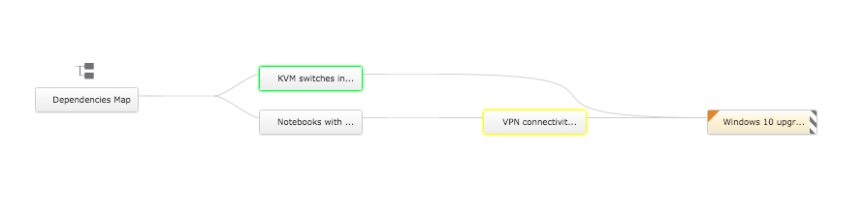
CREATING DEPENDANCIES BETWEEN REQUESTS
FEATURE: DEPENDENCY MAP
The dependency map helps keep track of relationships between the tickets.
Makes the master ticket the parent.
Creates dependencies between tickets as seen in the dependencies map.

Slide 15
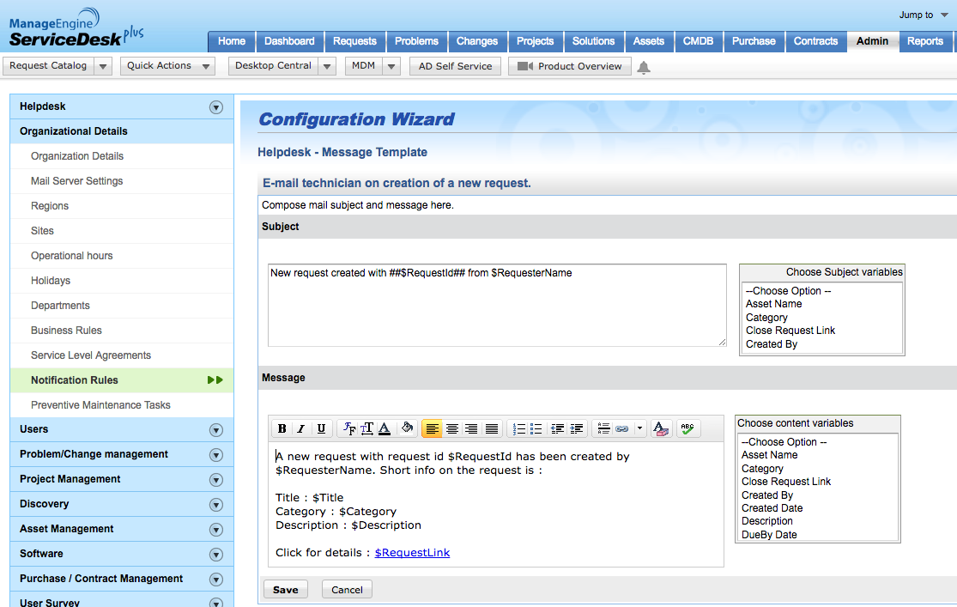
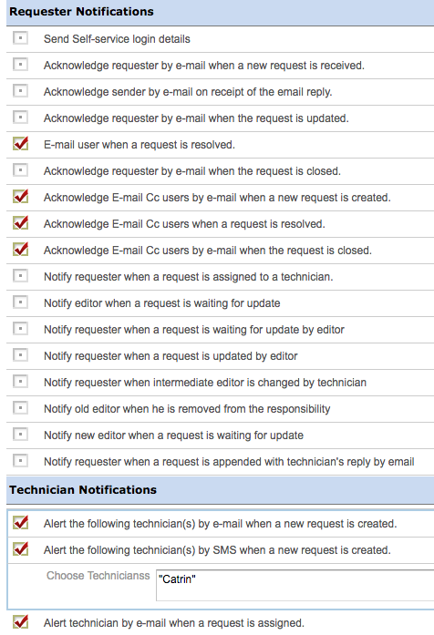
CREATING NOTIFICATION RULES
FEATURES: NOTIFICATION RULES AND TEMPLATES
Catrin enables the notification rules to ensure that the technicians stay updated on ticket (request) creation and on the progress of the tickets. She also modifies the notification templates specific to each event to enhance response time.
Catrin enables notifications to alert technicians on important updates.
Catrin customizes the request (ticket) notification templates.

Slide 16
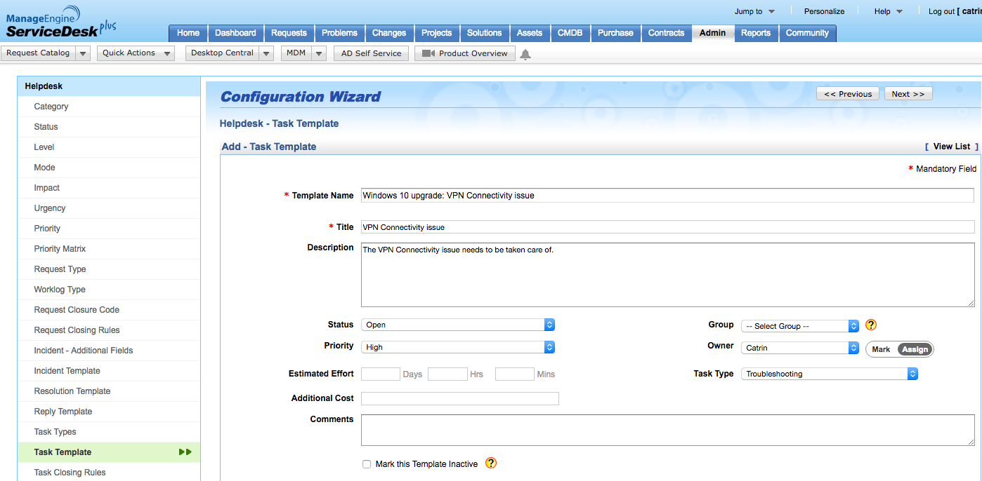
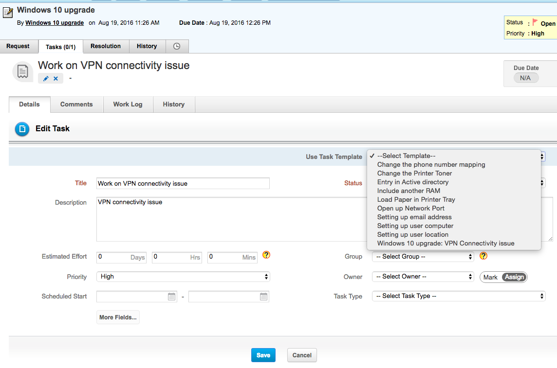
CREATING TASKS
FEATURES: TASKS AND TASK TEMPLATES
Catrin defines the task templates and adds tasks to the parent ticket so that technicians can finish those tasks required to close the parent ticket.
Catrin creates tasks templates in the admin module.
Associates the task template to the appropriate task in the parent ticket.

Slide 17
A happy ending with ServiceDesk Plus!
NOTIFY
Automated notifications ensure that technicians are alert at all times.
3
TASKS
Tasks allow technicians to have their own “to-do” list.
2
4
CLOSURE
Dependencies created ensure that the child tickets are closed automatically on closure of the parent ticket.
DEPENDENCY
Tickets added as dependencies to the parent ticket allow technicians to manage all the tickets pertaining to the issue in one place.
1
AUTOMATE
Using business rules, preconfigured workflows are created and the tickets are prioritized and assigned to relevant technicians. SLAs ensure response and resolution times and timely escalations.
5
CREATE
6
The master ticket is created in the portal.

Slide 18
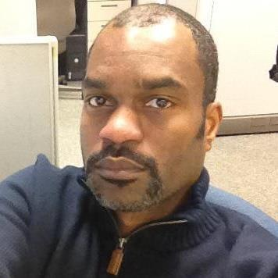
What customers say
ServiceDesk Plus has been a great decision both functionally and financially.
James Arnold
Service desk manager
Manhattan Associates

Slide 19
100,000+
IT service desks
700,000
IT technicians
185
Countries worldwide

Slide 20

Get ServiceDesk Plus
Join the 100,000+ IT help desks worldwide.
Sign up for a 30-day free trial.
Have questions? Drop us a line at hello@servicedeskplus.com

