Slide 1





ADManager Plus
Identity Risk Assessment

Slide 2

  Outline
ADManager Plus: Your go-to hybrid AD IGA tool
Remediation measures
ADManager Plus Identity Risk Assessment
Risk assessment report
Identity Risk Assessment Dashboard
Benefits of ADManager Plus Identity Risk Assessment
AD and Microsoft 365 Risk Assessment
Why ADManager Plus?
Risk score computation

Slide 3











Management
Identity Risk Assessment
  ADManager Plus: Your go-to hybrid AD IGA tool
Event-driven Automation
Reporting
ADManager Plus is an identity governance and administration (IGA) tool to securely manage and govern the identities in AD, Microsoft 365, Exchange, and Google Workspace environments
Delegation/ Workflow
Identity
Orchestration
Access certification campaign
Backup and recovery

Slide 4

  ADManager Plus' Identity Risk Assessment
The identity risk assessment report in ADManager Plus provides the list of potential identity risk indicators in AD and Microsoft 365 environments.
ADManager Plus relies on NIST SP 800-30 to assess the likelihood of occurrence and impact level of risk indicators to compute a
risk score.
Remediation measures are provided for every risk indicator, which will aid in improving the risk score.

Slide 5
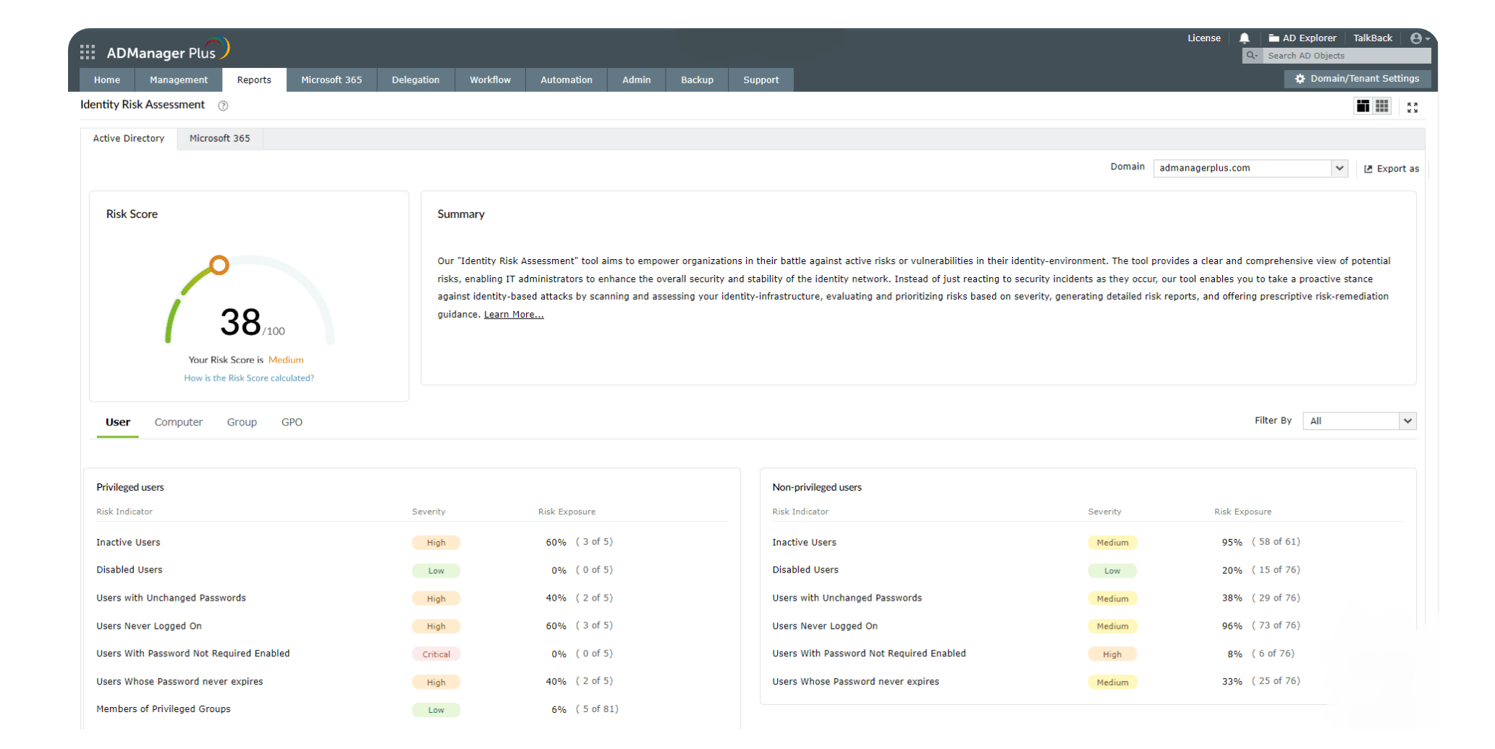
  Identity Risk
  Assessment dashboard
Get a comprehensive view of the potential risks in your AD environment.
Filter and prioritize risk indicators based on their risk severity.
Risk score is an indicator of your overall risk posture. It can be low, medium, high, or critical.
Risk exposure signifies the percentage of objects vulnerable to a particular risk.

Slide 6
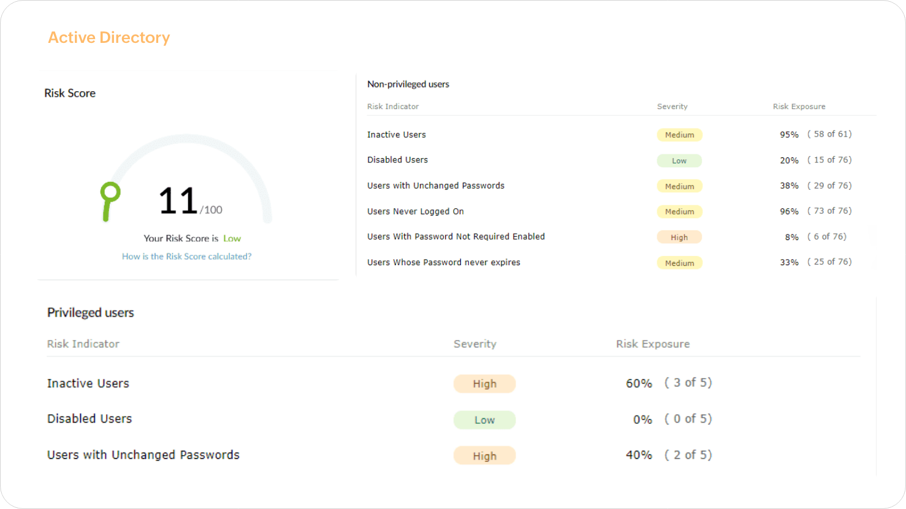
  AD and M365
  Risk Assessment
ADManager Plus conducts a thorough analysis of AD and Microsoft 365 risk levels, using indicators such as privileged and non-privileged user accounts, computers, and groups to assess potential vulnerabilities.

Slide 7



  Risk score computation
ADManager Plus conducts assessments of active risks within your identity environment. All identified risk indicators undergo a comprehensive three-phase computation process.
Phase 2
Phase 3
Phase 1
Assigning weightage and calculating risk exposure
Determining the risk score
Determining
the severity
For an in-depth explanation of the detailed risk scoring methodology, click here.

Slide 8
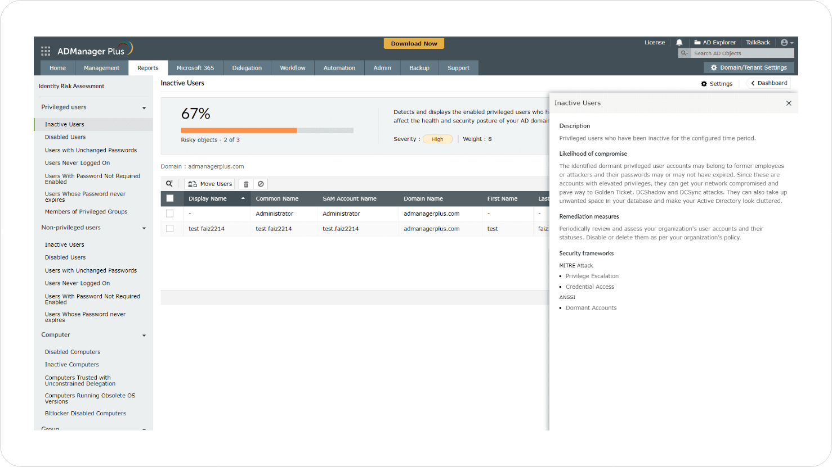

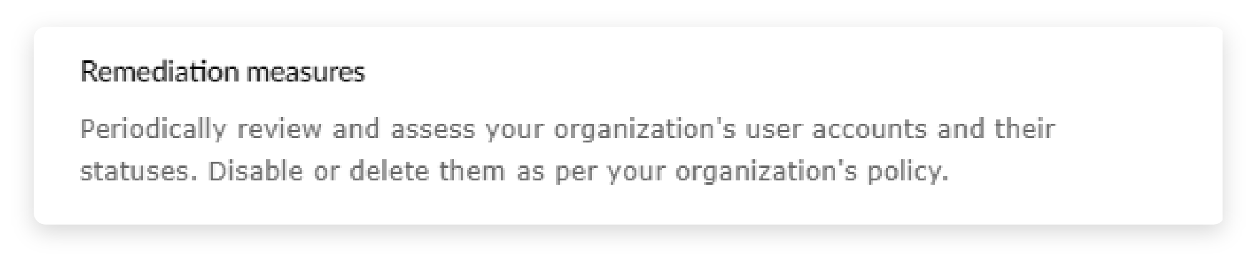

  Remediation measures
ADManager Plus provides Remediation measures based on MITRE framework to eliminate the identified risk indicator.

Slide 9



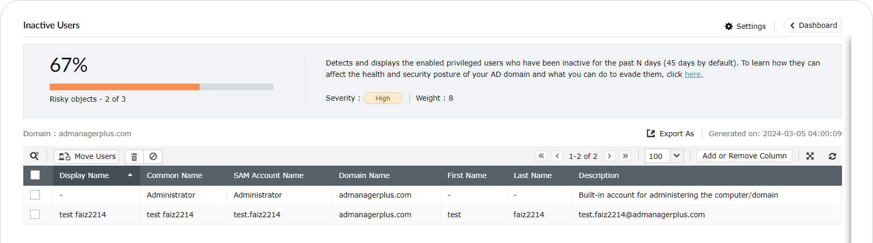
  Risk assessment report
  Granular reports
  Built-in management actions
  Export dashboard
Each risk indicator comes with a detailed report that lists the AD and Microsoft 365 objects responsible for it.
Read the recommended mitigation actions from the report and take actions right away using the built-in provisions.
Export the entire risk assessment dashboard with the list of all the risk indicators and their respective mitigation actions to be shared with the concerned stakeholders.

Slide 10

  1
Foresee threats and mitigate them
Identifying and mitigating risks even before they can pose a security threat helps you avoid security breaches, ransomware attacks, and other threats in AD and Microsoft 365 related attacks, which can cost a fortune.
  2
Achieve compliance
  Benefits of ADManager Plus
  Identity Risk Assessment
Meet the compliance requirements set by mandates like the SOX, HIPAA, FISMA, GDPR and PCI DSS.
  3
Improve incident management
Enhance incident response by utilizing the on-the-fly management actions provided by the Risk Score dashboard, thereby keeping the risk score in check.
  4
Strengthen risk posture
Strengthen your cybersecurity game by identifying risk indicators, mitigating them, and fortifying your network and data from them.

Slide 11



Streamlined identity life cycle management
Multi-level business workflows
Secure data backups and recovery
200+ pre-packaged reports
  Why
  ADManagerPlus?
Template-based, event-driven automations
Unleash the Power of
ADManager Plus with its:
Integration with popular SIEM, HCM, ITSM and help desk tools
Periodic access certification campaigns
iOS and Android mobile apps for on-the-go management
Explore ADManager Plus' full potential! Register here for a free product demo.
Register here

Slide 12

  Thank you!

