Slide 1


ADManager Plus
A powerful tool for Active Directory management and automation

Slide 2
Business challenges
Overwhelmed by manual AD tasks?
Experiencing difficulties in managing group memberships and access permissions?
Struggling to keep GPOs updated and consistent?
Struggling to manage and understand permission inheritance in complex folder structures?
Having trouble performing bulk operations, like creating user accounts in bulk or resetting passwords of multiple users?
Finding it challenging to automate the provisioning of new users in Microsoft 365 and deprovisioning of inactive accounts in a hybrid setup?

Slide 3

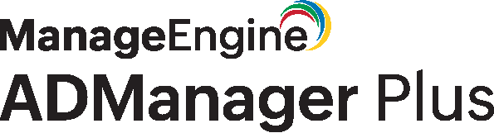
Drawbacks
of native tools
Reliance on PowerShell
Demands advanced scripting skills
Poor UI
Complicated user interface
Complex management
Overly intricate and time-intensive
Security challenges
No predefined, role-based administrative delegation options to non-IT users like managers, HR personnel, and service desk technicians

Slide 4
AD management simplified
Streamlined user life cycle management
Customizable templates for bulk provisioning and re-provisioning
Bulk user management
OU management
File server management
GPO management
AD migration
Microsoft 365 user management
Overcoming native tool complexities
ADManager Plus enables administrators to seamlessly manage AD users, computers, contacts, and groups with ease.
Capabilities of ADManager Plus

Slide 5

Capabilities
User data import
Streamlined user life cycle management
Efficiently import user data
User onboarding
Assign roles and permissions
Streamline new user
account creation
Efficiently import user data
Ongoing user management
Reporting and monitoring
Maintain and update
user info
Generate reports and track user activities
Provision user accounts across multiple platforms, such as AD, Microsoft Exchange, Microsoft 365, and
Google Workspace, simultaneously from a single console.
User account updates
User offboarding
Handle role changes and promotions
Efficiently manage
user exits
Account deactivation and deletion
Efficiently import user data

Slide 6
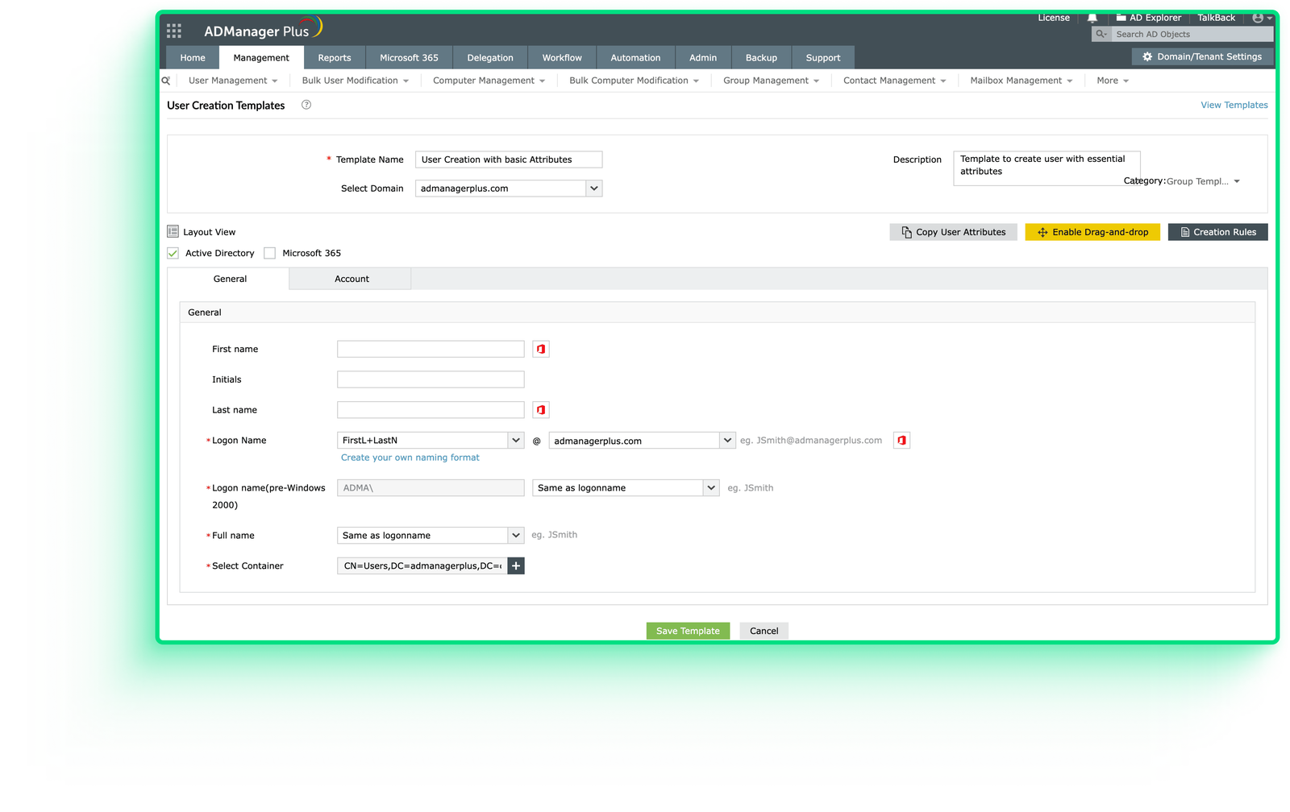
Capabilities
Customizable templates
Streamline AD management with customizable templates for users, groups, OUs, and GPOs
Simplify account creation by pre-filling standard attributes and auto-populating fields using Creation Rules
Assign templates to help desk technicians, manage duplicates, and auto-configure attributes
Simplify bulk operations like password resets, account creation, and managing inactive accounts via CSV import

Slide 7
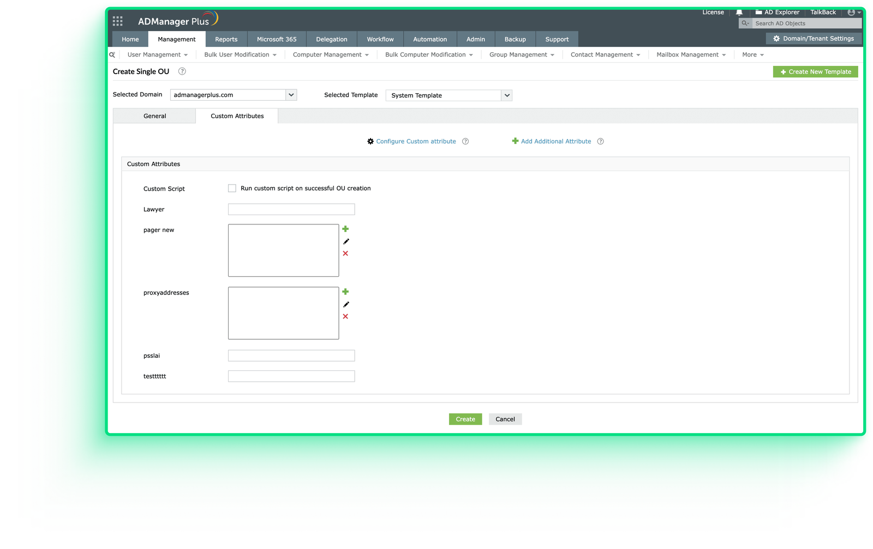
Capabilities
OU management
Create, modify, move, and delete OUs effortlessly to ensure efficient AD administration
Standardize OU creation with templates and manage multiple OUs simultaneously using the import CSV option
Perform all OU management tasks from a single, user-friendly console

Slide 8
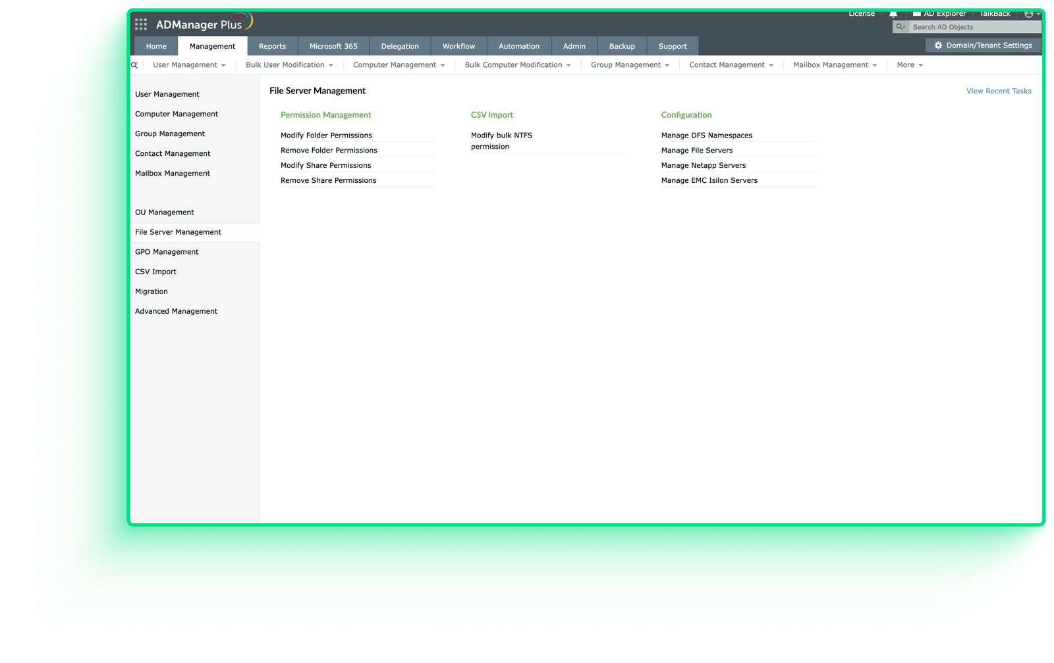
Capabilities
File server management
Manage NTFS and share permissions in bulk, ensure secure resource access, and perform bulk modifications
Manage permissions on AD, NetApp, and Isilon file servers from a single, central interface
Apply various permissions and limit scope to specific folders and sub-folders

Slide 9
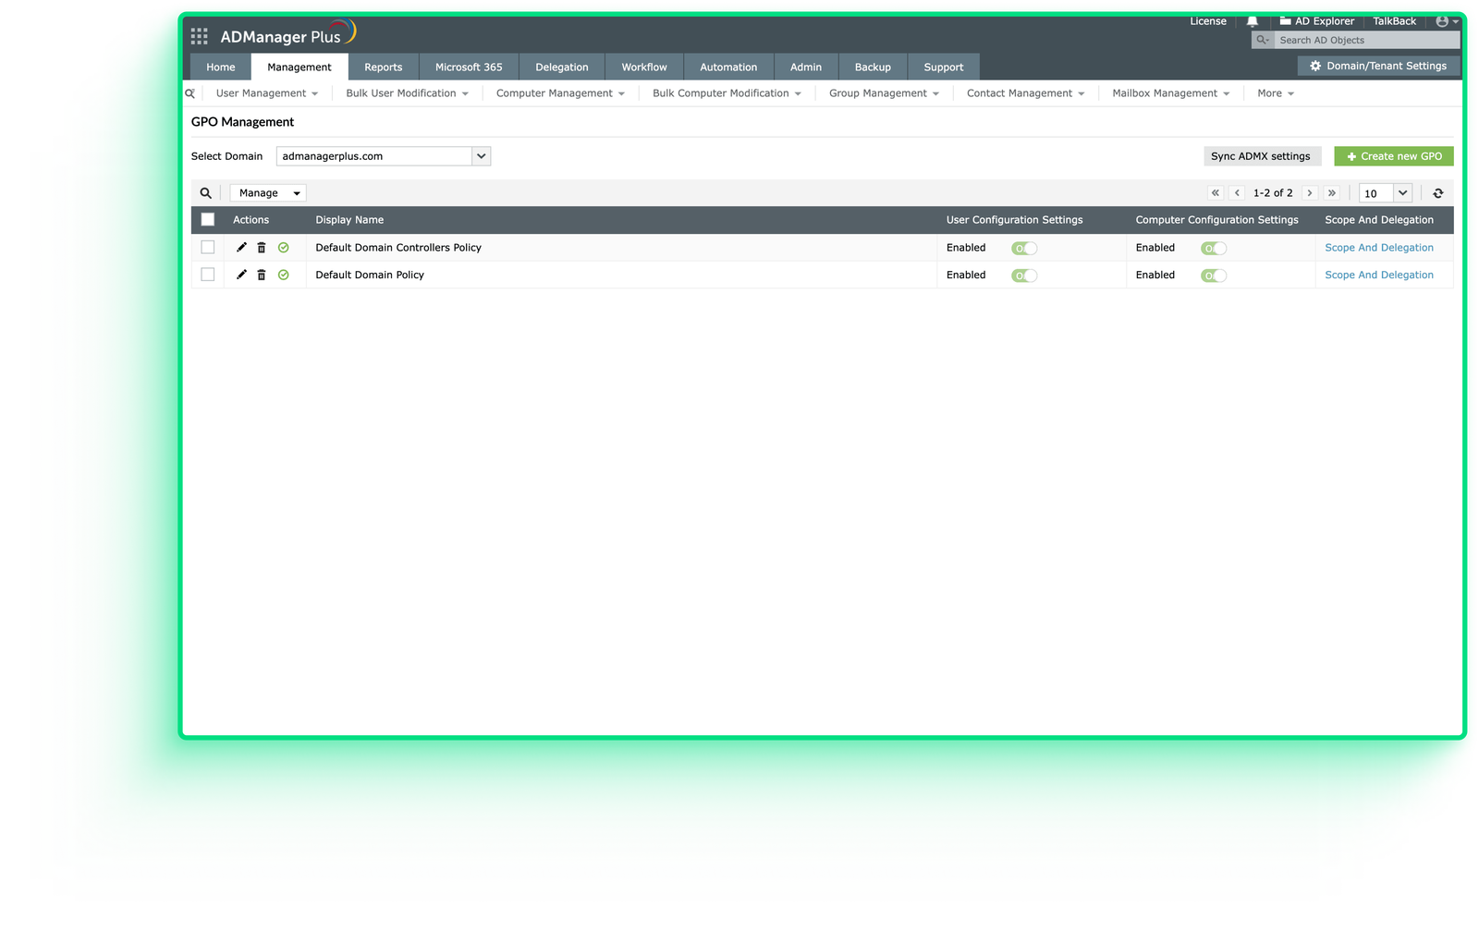
Capabilities
GPO management
Enable administrators to manage GPOs and their links effortlessly, facilitating key actions such as syncing administrative file templates, linking GPOs, and forcing updates to skip wait times.

Slide 10
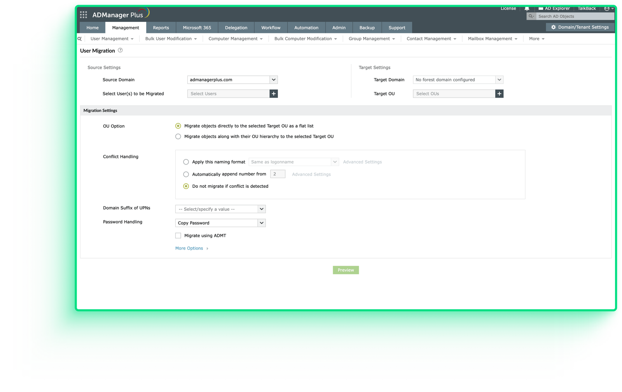
Capabilities
Migration
Simplify AD migrations with ADManager Plus. Easily migrate users, groups, contacts, and GPOs across trusted forests in your AD environment, with or without the Active Directory Migration Tool (ADMT).

Slide 11
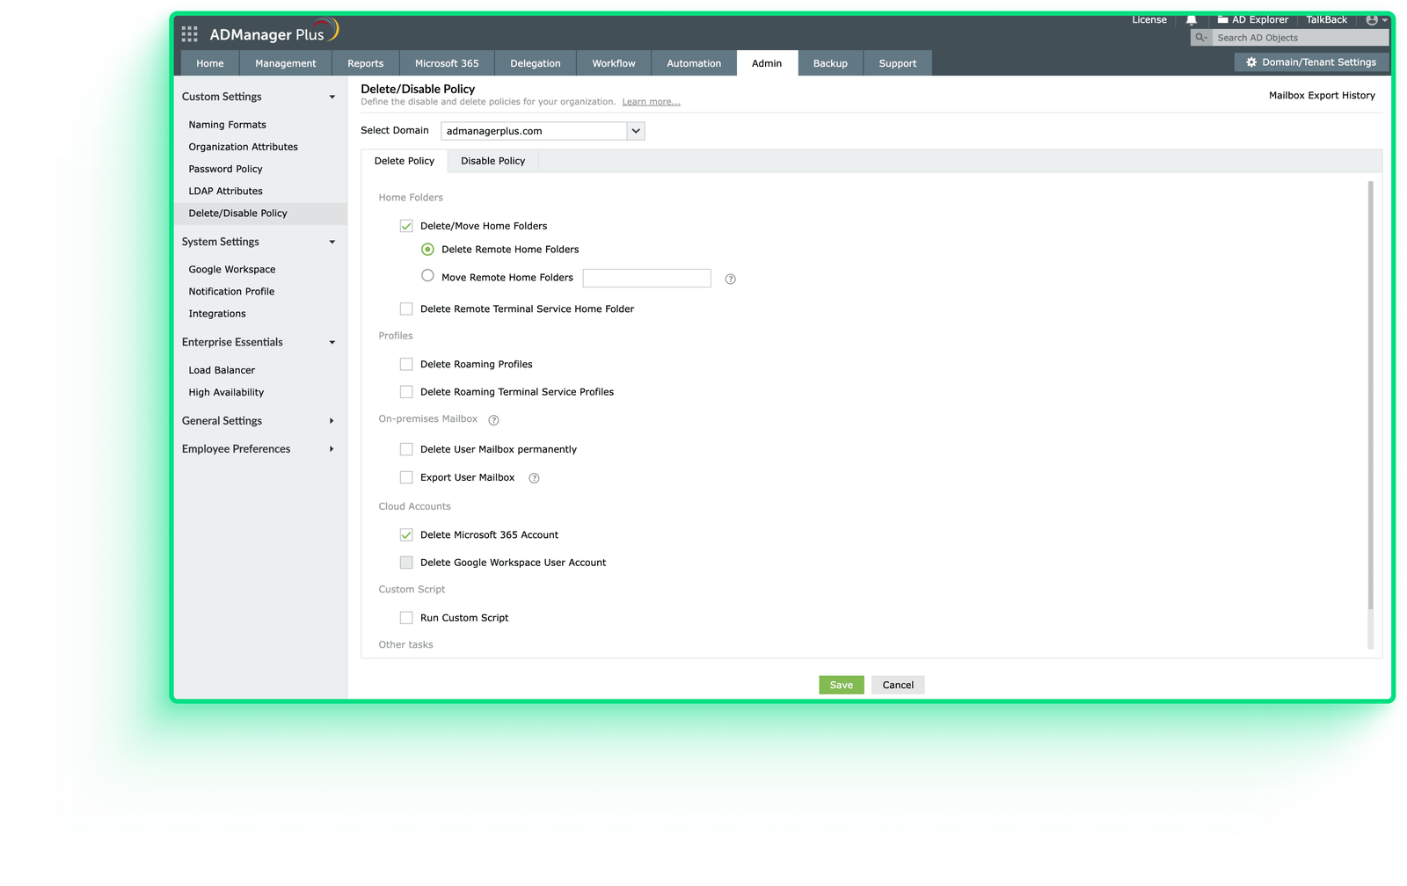
Capabilities
Delete and disable policy
Define domain-specific policies for user accounts in AD to automate actions such as deleting or disabling home folders, roaming profiles, Microsoft 365 and Google Workspace accounts, and more.

Slide 12
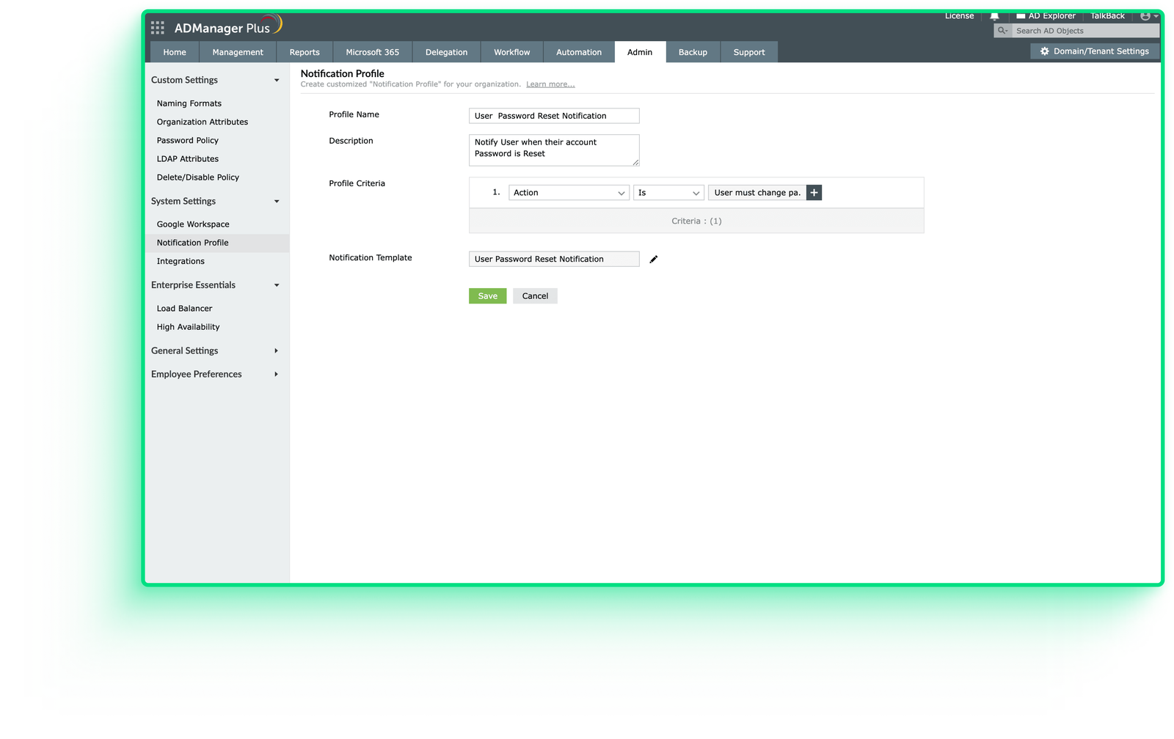
Capabilities
Real-time notifications
Configure ADManager Plus to notify administrators or technicians of any AD changes via SMS or email
Create notification templates and profiles for custom messages and recipient configurations

Slide 13

USE CASE
Montmorency's user admin ally
Business challenge
ADManager Plus
For College Montmorency
College Montmorency enrolls 6,000+ new students annually, making AD user creation resource-intensive
Most user attributes are consistent, but transferring data from CSV to AD accurately is challenging
Efficient management can significantly reduce time and resource use
I have to recreate more than 6,000 users yearly. ADManager Plus help create these in less than a few hours. I have much more time left for other tasks, and errors occur less often since the template lets you configure your users.
Predefined templates simplify setting up user attributes
CSV bulk-user import for easy data transfer
All-in-one tool for AD management and user administration
Intuitive interface with detailed, easy-to-understand reports
—Cuauhtemoc Gagnon,
IT infrastructure technician, College Montmorency

Slide 14




Benefits
of using ADManager Plus for AD management
Cost-effective
Scalability
User satisfaction
Saves cost by streamlining AD management processes, reducing the need for manual intervention, and minimizing downtime
Scales easily to accommodate growing organizational needs, ensuring that AD management remains efficient and effective as the organization expands
Increases user satisfaction by providing a seamless experience for managing user accounts

Slide 15




For technical support:
Contact us
+1-408-916-9393
support@admanagerplus.com
Www.admanagerplus.com
Chat live with our support team
Personalized web demo
Download ADManager Plus now

