Slide 1
Combating snake, a new type of ransomware: Detection and mitigation strategy
abi@manageengine.com

Slide 2
The focus is on ransomware –But it doesn’t end there
Here are some resources you will definitely find useful.
Ransomware demystified ebook – With special focus on SNAKE ransomware
Become cyber aware now
Behind the scenes of the most devastating breaches in 2020.
Twitter security hack
San Francisco airport website hack
The NTT Active Directory server hack

Slide 3
Agenda
Typical ransomware attack kill-chain
Why is snake ransomware darker than the others?
Analyzing the internal working of SNAKE
Antidote to the venom: Detection and mitigation strategy

Slide 4
Anatomy of a ransomware attack – It all starts with a click

Slide 5
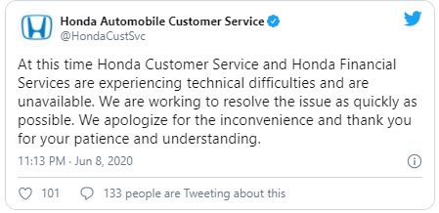
EKANS – A new species of ransomware

Slide 6
Why is SNAKE darker than typical ransomware?
Unlike other malware, snake disables remote management (Basic for Windows environment administration)
Has a static 'kill list‘ of processes. This level of intentionality previously absent from ransomware
Uses legitimate Windows features (firewalls, group policies, WMI) to block communication and spread across the network.
It cripples every single computer in the network, unlike other ransomware

Slide 7
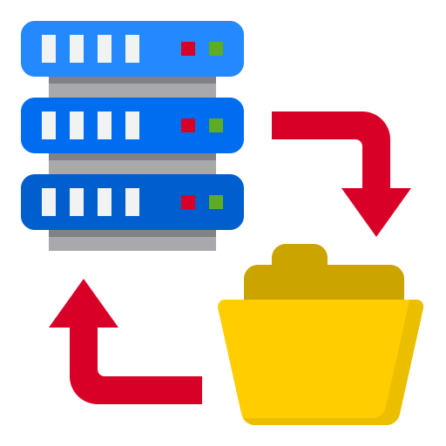
SNAKE ransomware attack kill-chain
Eliminate all chances of resurrection (Destroys services, VSS copies)
Lock down the network
(Leaves no signature when encrypting folders)
Extort ransom for decryption key
(Leaves a note only on DC’s)
Exposed RDP credentials
(Not phishing)
Disables communications (Windows Firewall manipulation)
Notes:
Have added a few pointers in each box here showcasing why SNAKE is more dangerous.

Slide 8
Analysing the internal working of SNAKE

Slide 9
#1: Initial infection phase

Slide 10
RDP is a main entry point for intrusion
Unlike traditional ransomware, SNAKE is a targeted ransomware. It does not rely on phishing emails or malicious removable drives to intrude.
Companies such as Honda and ENEL were subject to this ransomware attack due to exposed RDP credentials,
RDP Exposed: /AGL632956.jpn.mds.honda.com
RDP Exposed: /IT000001429258.enelint.global
The SNAKE perpetrator already has target rich knowledge (about the server), even before launching the attack.

Slide 11
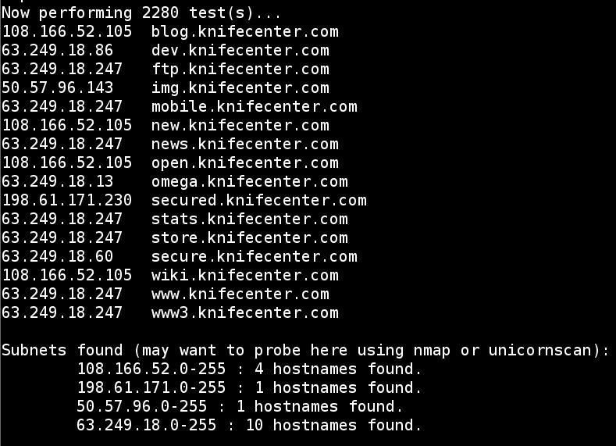
External DNS recon to find details of the target domain

Slide 12
Windows external RDP port brute-force
Cyber attackers have taken advantage of sysadmins working remotely and are dedicating more resources to scanning for the standard RDP port 3389 to see what has been exposed.
Should always be open for connecting via RDP to any server
Windows remote desktop external brute force

Slide 13
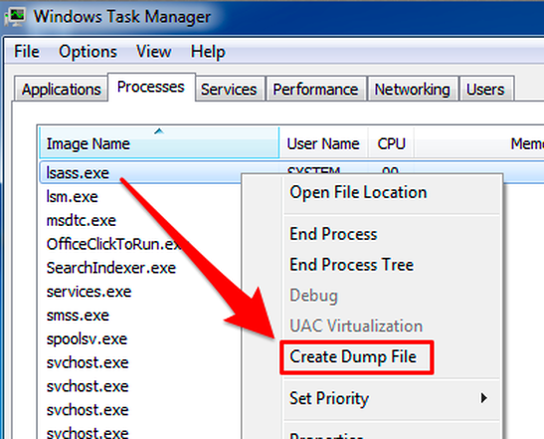
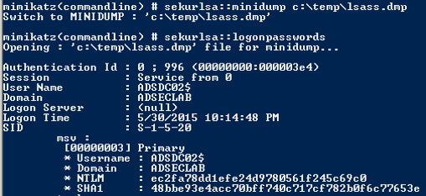
Compromised endpoint? Extract RDP creds from memory!

Slide 14
The “targeting’’ behaviour of SNAKE
Specific-domain name resolution is checked, for instance
MDS[. ]HONDA[. ]COM
SNAKE also checks name resolution for the above domain is equal to the following IP address,
170[.]108[.]71[.]15
If not equal, it will terminate the operation. SNAKE also registers a mutex called "EKANS" to compromised systems, this prevents multiple infections.

Slide 15
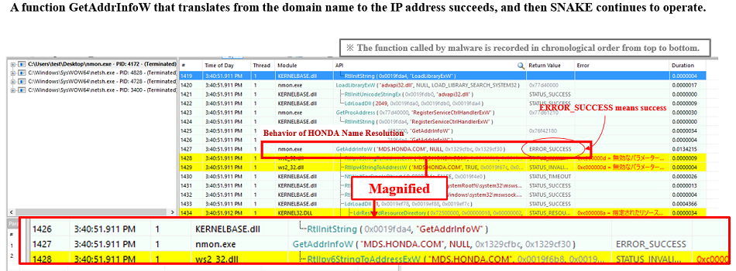
In case the domain cannot be resolved, errors are returned to GetAddrInfoW function, SNAKE stops working and terminates.

Slide 16
#2: Establishing foothold and blocking all communication

Slide 17
Disabling firewall communication
Once SNAKE realizes it is a good operating environment, it modifies Windows firewall settings.
This phenomenon is unique to SNAKE!
The command above is passed to netsh.exe, a network tool in Windows, which used to block all incoming and outgoing connections for all profiles.

Slide 18
But hold on. There is a catch!
The Windows firewall operation by netsh.exe requires administrator’s privileges/system privileges.
There is no function in SNAKE to escalate privileges when it is executed with user privileges.
This is evidence that this specimen may have been developed under the assumption that it is executed with admin privileges from the beginning.

Slide 19
SNAKE spreads through the domain controller
Since admin privileges are already obtained, the attacked company’s domain controller is used to spread the ransomware across the local network.
Spreads from domain policy script folder (SYSVOL)\domainname\scripts) . These files were found in the domain policy script folders:
nmon.exe
nmon.bat
KB3020369.exe

Slide 20
#3: Killing multiple processes and backup destruction

Slide 21
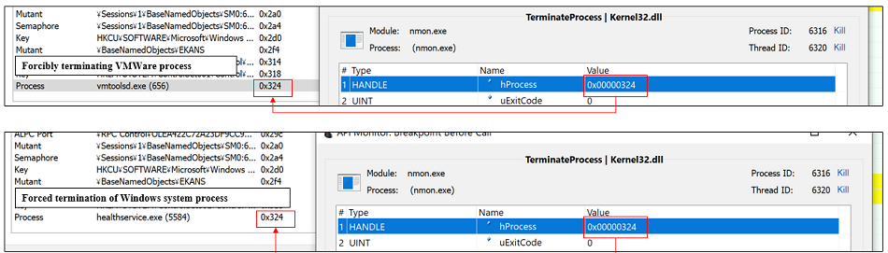
Terminates any process that may hinder encryption
Note the nmon.exe process everywhere!
Deletion of shadow copies is consistent with ransomware execution
Check out this link for a list of processes SNAKE kills

Slide 22
#4: Encryption and locking down file/folder data

Slide 23
Encrypts all files except the core Windows files
After the environment settings are ready, SNAKE searches to encrypt the files in Recycle.Bin (Trash folder) found at the beginning of the C drive.
After that, the accessible files contained in each folder of the PC are encrypted one after the other.
Windows system folders (such as system-based files and Windows folders) are excluded from encryption, so Windows remains operational even when infected with SNAKE.
nmon.exe, performs file encryption

Slide 24
List of files ignored by SNAKE
:\Recycle.Bin
:\ProgramData
:\Users\All Users
:\Program Files
:\Local Settings
:\Boot
:\System Volume Information
:\Recovery
\AppData\

Slide 25
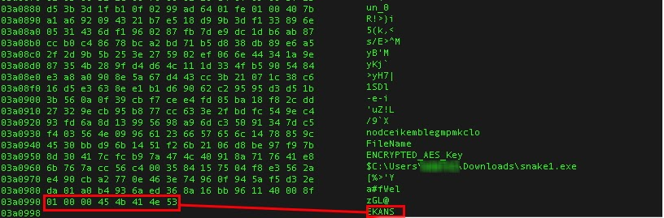
How does the encryption happen?
A footer is added to the end of encrypted file, with the original file name and the AES key encrypted with the RSA public key, and a "EKANS" marker is added to the last 5 bytes to indicate that the file was encrypted with SNAKE.
A symmetric key will be used to first encrypt the files, after which it will in turn be encrypted with the attacker's public key.
The private key is with the attacker, which will only be returned after the ransom payment!

Slide 26
After file encryption
A random 5 character extension, all signature based ransomware detection strategies fail!
SNAKE first encrypts all files (without changing file extensions). Once all encryptions are done, it changes all file extensions at a time (doc1.docx.ragnar_0DE48AAB)

Slide 27
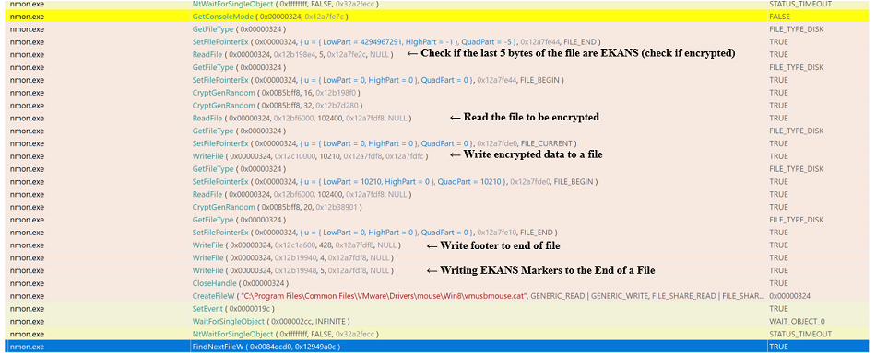
Encryption happens using default Windows processes
Uses read/Write file process from Windows API
Uses Movefile_replace to avoid detection, a commonly used process

Slide 28
#5: Extortion and blackmail

Slide 29
Disabling all previously modified firewall rules
When all encryption are completed, SNAKE disables all firewalls with the following command:
SNAKE performs a series of tasks-
Blocks network communications in the firewall prior to encrypting files,
Prevents recovery activities and monitoring across the network during file encryption,
After file encryption is complete, removes the blocks.

Slide 30
The typical text file with a ransom note
Drops a ransom note only on the DC, does not encrypt files on the DC
(C:/users/public/desktop)
This is secondary evidence to the fact the attackers assume admin privilege!

Slide 31
Detecting and mitigating SNAKE ransomware (and others)

Slide 32
Monitor user logons (especially remote)
Monitor user logons, ensure you-
Enforce a network policy for all user logons
Monitor RDP, gateway, NPS, Radius and VPN logons, have a system in place to monitor logons from unknown IP addresses and hostnames
Enforce MFA for remote logons for added security
Capture account logon failures (indications of potential brute-force attacks)
Changes in user behaviour - a user logging on at odd hours/ accessing a host for the first time?

Slide 33
Monitor anomalies across your servers and firewalls
A list of processes suddenly killed/shutdown?
Mysterious, unknown processes created on member servers?
Changes to firewall rules, attempts to block inbound and outbound communication?
Firewall traffic, website traffic, and more importantly is the source’s IP legitimate?

Slide 34
Track all your files and folders for changes
Deletions of shadow copies (vssadmin list shadows) of servers in the network.
File/folders renamed, modified, created or deleted.

Slide 35
Track changes on Group policy Objects (GPO)
Attackers may use the software installation feature of group policies to propagate ransomware.
Unauthorized users may be granted remote logon privileges on a server using group policies.
Don’t forget to always monitor the (SYSVOL)\domainname\scripts) folder across your domain controllers to detect the presence of ransomware.

Slide 36
Proactively track administrator activities
Password reset/changed for an administrator account?
An unauthorized user added to an admin group?
An explicit ACE/ACL modification on a user account?
Users running malicious scripts on their workstations?
User given explicit logon rights to a DC?

Slide 37
Acknowledgements
https://www.mbsd.jp/blog/20200623.html

Slide 38
We can help.
A single console for defending against ransomware attacks.

Slide 39
abi@manageengine.com
Thank you!

